Slide 1
Group 20​ Progress Report
Presented By
Huang Yulin
Hu Silan
Pang Weicong
Yang Jiajun

Slide 2
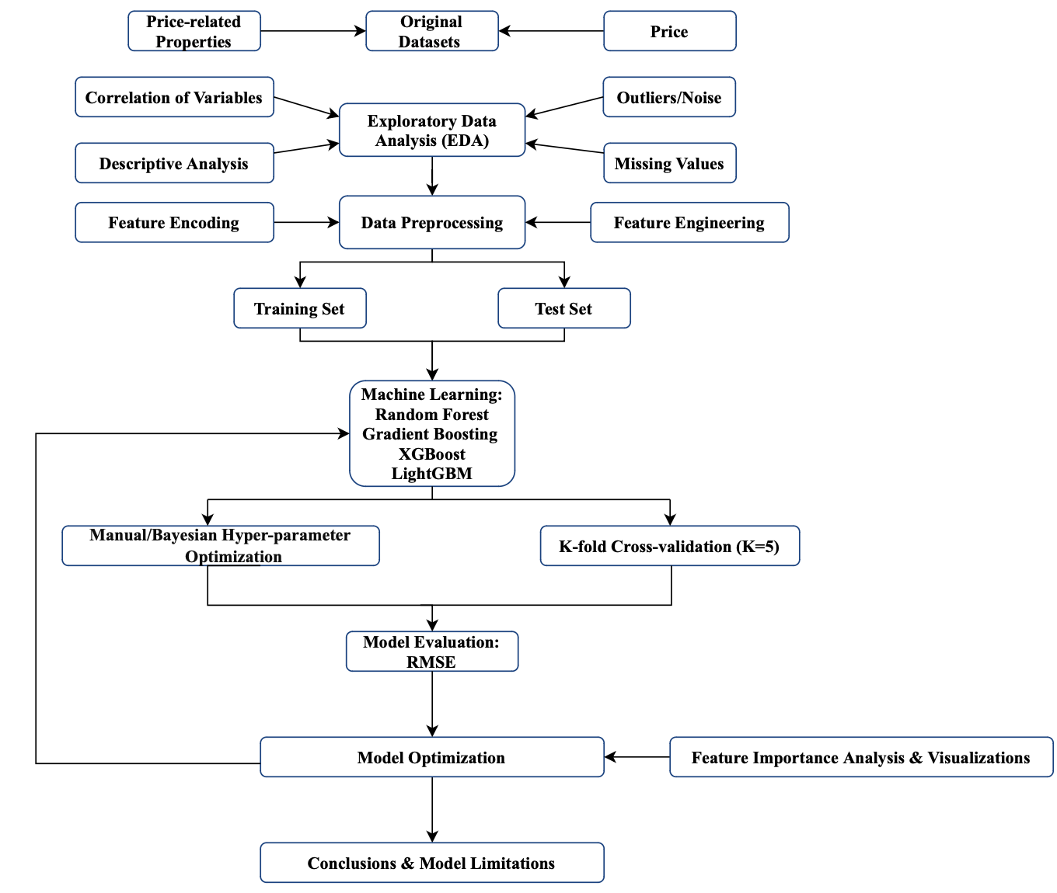
Project Description
1.
What we’ve already done preliminarily

Slide 3
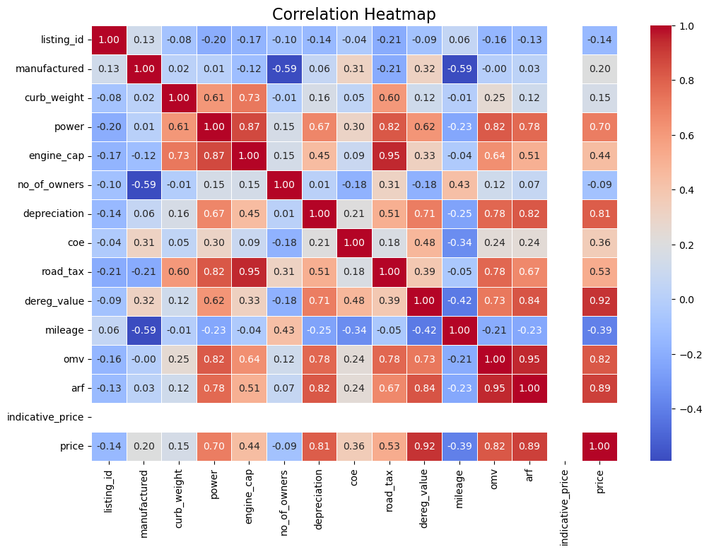
EDA
2.
Figure 2. Correlation of Numerical Data
Arf, omv, dereg_value, depreciation, power are strongly correlated with price.
Manufactured, curb_weight, no_of_owners are weakly correlated with price.

Slide 4
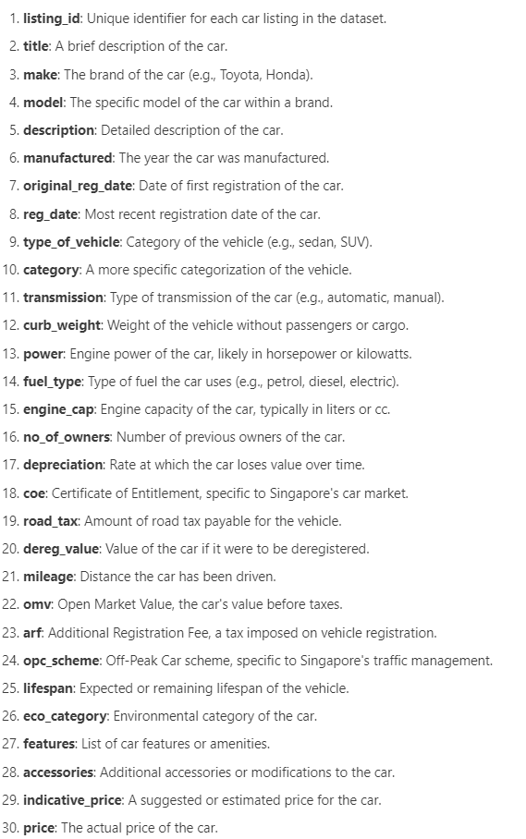
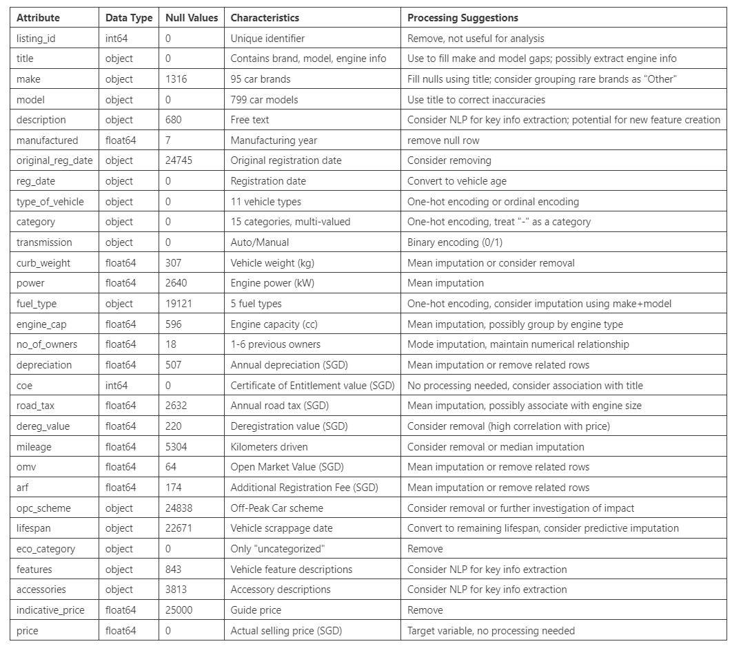
EDA(Understanding Each Attribute)
2.

Slide 5
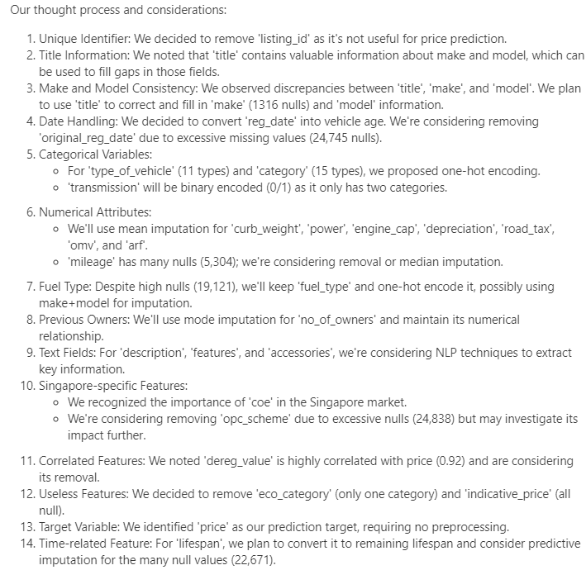
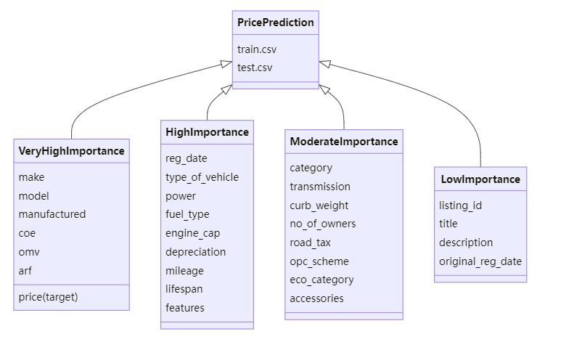
EDA(Consideration)
2.

Slide 6
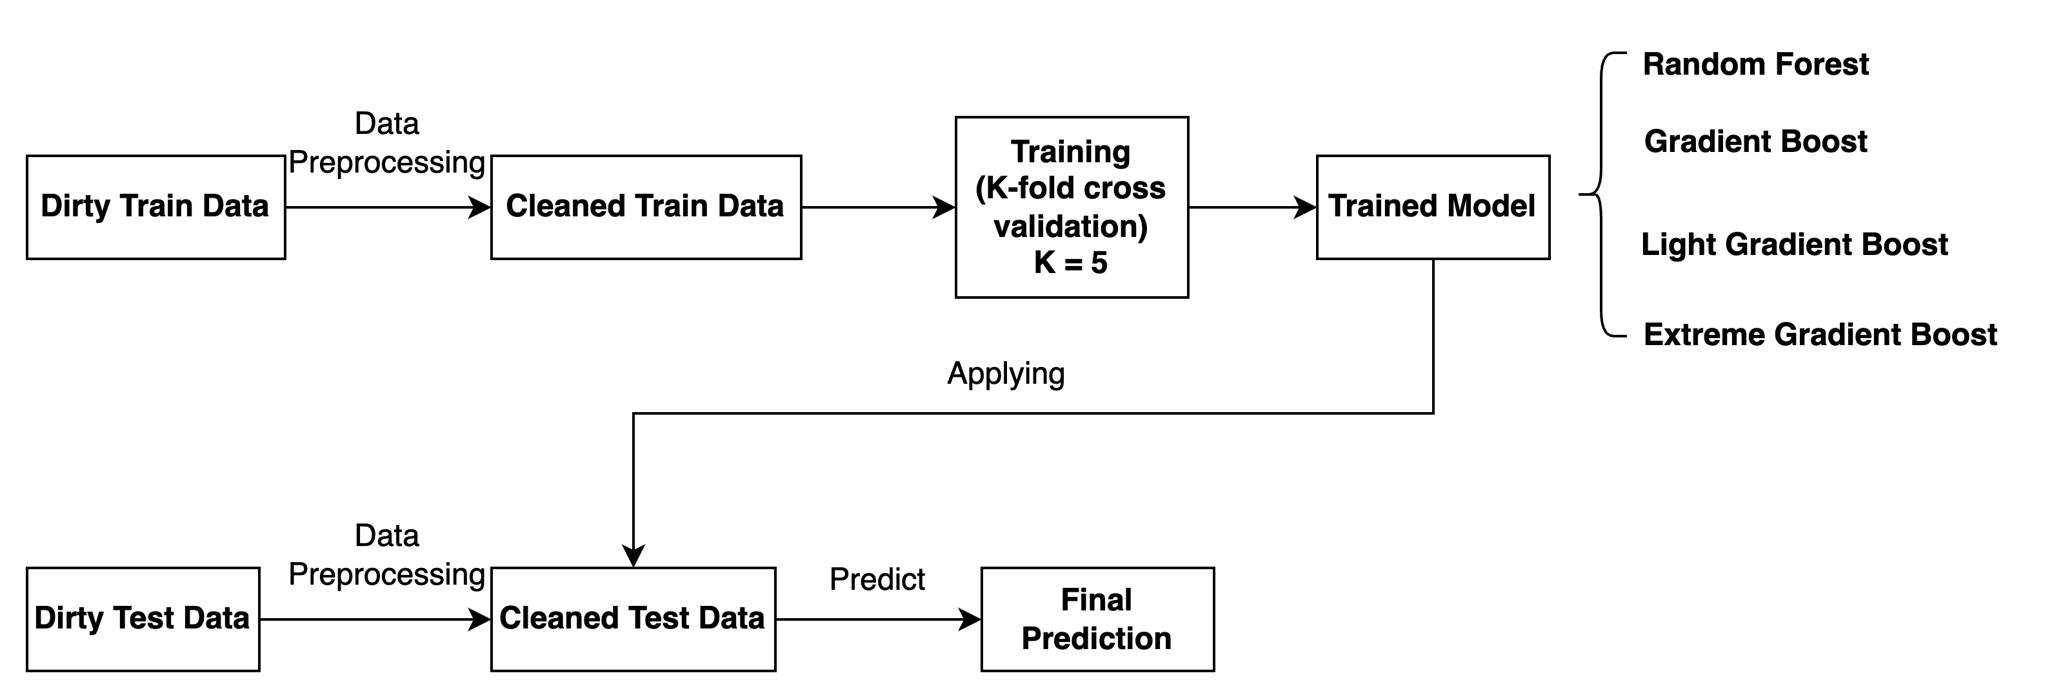
Pipeline of the work

Slide 7
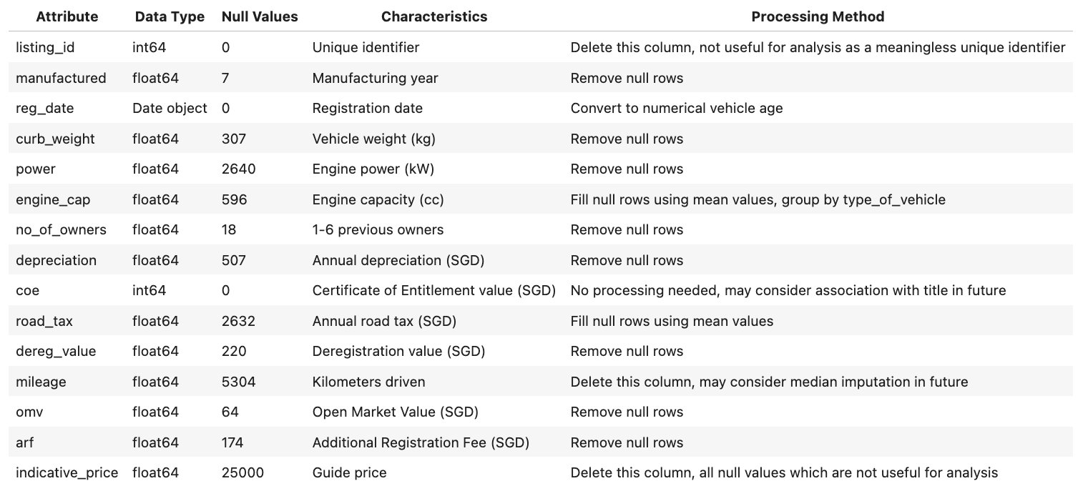
Process on Numerical Data
3.1
Table 1. Processing on Numerical Data

Slide 8
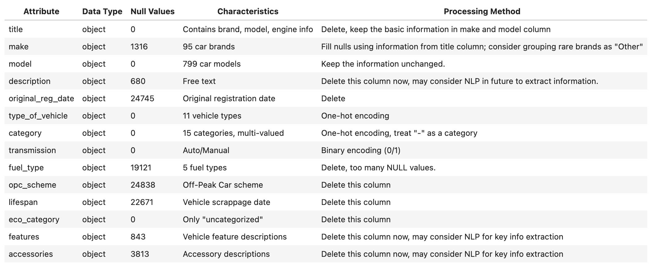
Process on Non-numerical Data
3.2
Table 2. Processing on Non-numerical Data

Slide 9
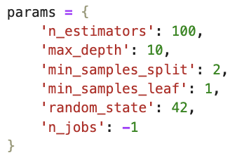
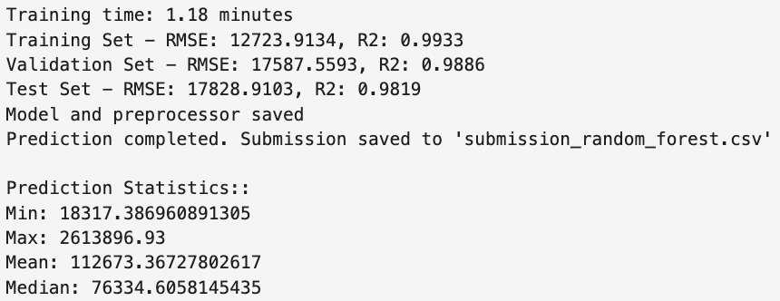
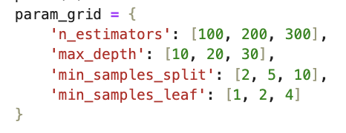
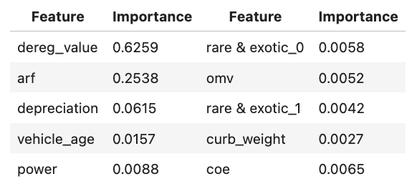
Bagging Method - Random Forest
4
Random Forest
Kaggle Test Data Result:38126.45824
Running result
Will try to find batter parameters later and rank
the importance of features
Top 10 important
features

Slide 10
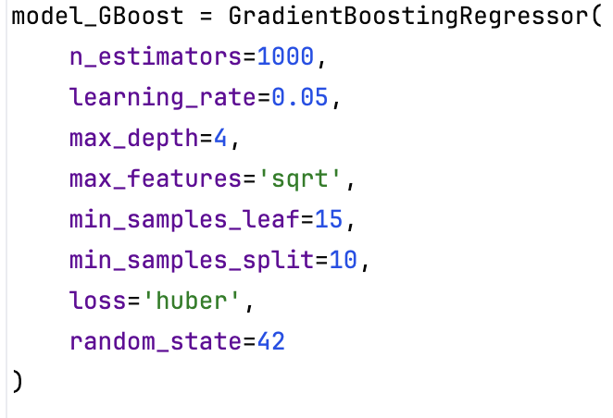
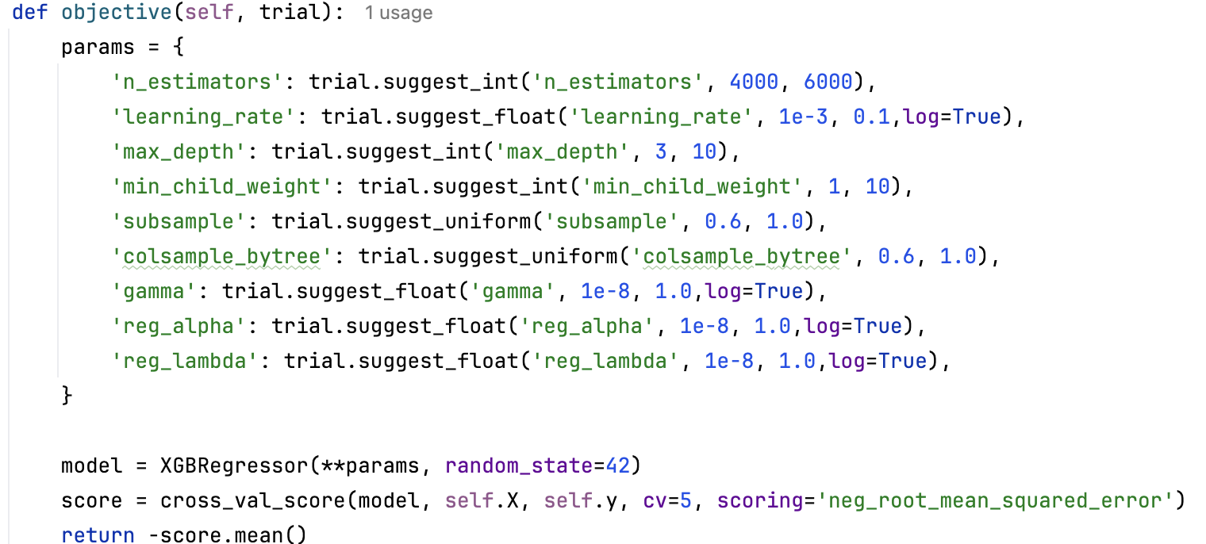
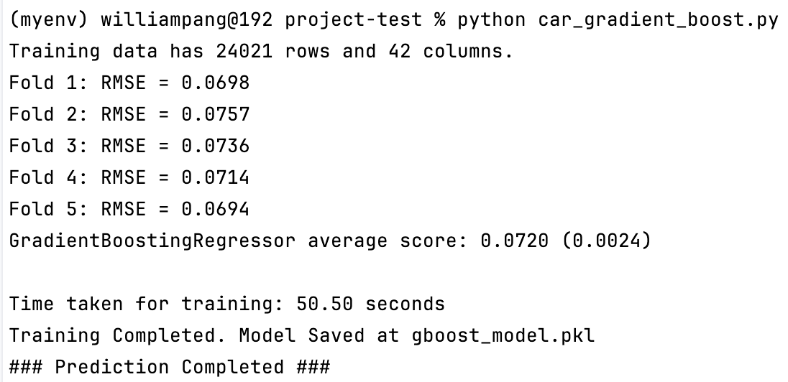
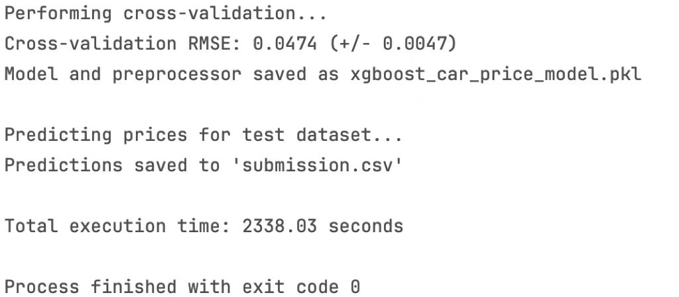
Boosting Method
5
Gradient Boosting
Kaggle Test Data Result:40934.42705
XGBoost
Kaggle Test Data Result:44981.79731
Train Result (Apply K-fold(k=5) training method):
Train Result (Apply K-fold(k=5) training method):

Slide 11
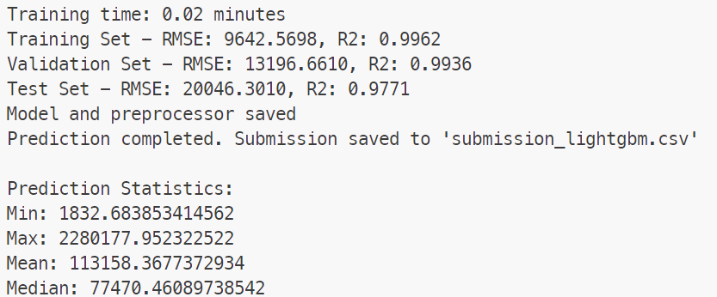
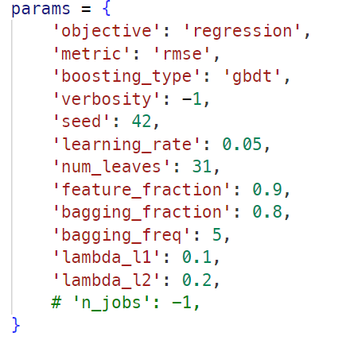
lightGBM
5
lightGBM
Kaggle Test Data Result:35376.42778
Running result
I was thinking about whether I need to separate training and prediction based on vehicle type, but in fact, I did a simple experiment and the training time was greatly improved, but the effect was not good either.
I think it’s data preprocessing, and feature engineering needs to be rethought.

Slide 12
Future Work
6
6.1 Data Processing Improvements
Enhanced feature engineering
More Sophisticated missing data imputation techniques (we currently used Mean for imputing missing values)
Advanced NLP for text data (e.g., TF- IDF, Word Embeddings)
6.2 Model Optimization
Hyperparameter Optimization: Focus on optimizing the hyperparameters of the LightGBM model
Model Ensemble: Explore alternative model architectures, such as Support Vector Machines (SVM), and combine their predictions with those of the LightGBM model to create a more robust ensemble model.
6.3 Feature Importance Ranking
Feature Importance: Built-in LightGBM function that measures importance based on how often a feature is used for splitting in decision trees. It's simple but may not be fully accurate.
Permutation Importance: Measures importance by shuffling feature values and observing the change in model performance. More accurate but computationally expensive.
SHAP (SHapley Additive exPlanations)

